Slide 1
Chapter Five String Matching
Knuth-Morris-Pratt’s (KMP) Algorithm
String Processing with Dynamic Programming
String Alignment (Edit Distance)
Longest Common Subsequence

Slide 2
String Matching
Given a string ‘S’, the problem of string matching deals with finding whether a pattern ‘p’ occurs in ‘S’ and if ‘p’ does occur then returning position in ‘S’ where ‘p’ occurs.
O(mn) Approach:- One of the most obvious approach towards the string matching problem would be to compare the first element of the pattern to be searched ‘p’, with the first element of the string ‘S’ in which to locate ‘p’. If the first element of ‘p’ matches the first element of ‘S’, compare the second element of ‘p’ with second element of ‘S’. If match found proceed likewise until entire ‘p’ is found. If a mismatch is found at any position, shift ‘p’ one position to the right and repeat comparison beginning from first element of ‘p’.

Slide 3
KMP Algorithm
A linear time algorithm for the string matching problem.
A matching time of O(n) is achieved by avoiding comparisons with elements of ‘S’ that have previously been involved in comparison with some element of the pattern ‘p’ to be matched. i.e., backtracking on the string ‘S’ never occurs

Slide 4
Preprocessing
This is the part of the algorithm which fetches a space complexity of O (m) and a time complexity of also O (m) .
The pre-processing phase is where we identify certain properties of the given pattern and store certain information we’ll find handy later on.
This “information” we store is the length of the longest prefix which is also the suffix(border).
Border if a string is both prefix and a suffix.
Let lps[ i ] represent the length of the longest suffix that is also a prefix, in the first (i) characters. Here’s an example.

Slide 5
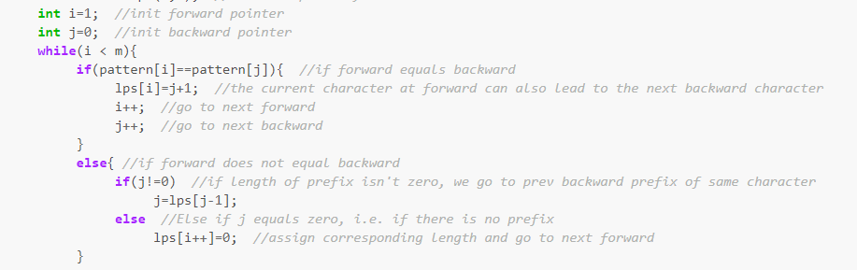
Preprocessing
Let my pattern string be P =“abcdabcde”
a, ab, abc, abcd , abcda , abcdab , abcdabc, abcdabcd , abcdabcde
And they’re corresponding lps [ ] values are = { 0, 0, 0, 0, 1, 2, 3, 4, 0 } since we want the length of the bold suffix prefix.

Slide 6
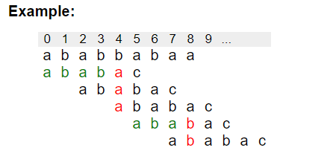
The String Matching
Now the efficiency of the KMP is achieved using the information of the border(string which are both suffix and prefix).
So when a mismatch occurs the algorithm tries to avoid comparison of borders and instead it just jump and continue by incrementing by the prefix width instead of just incrementing by one.

Slide 7
The String Matching
Unlike Naive algorithm, where we slide the pattern by one and compare all characters at each shift, we use a value from lps[] to decide the next characters to be matched. The idea is to not match a character that we know will anyway match.
We start comparison of pat[j] with j = 0 with characters of current window of text.
We keep matching characters txt[i] and pat[j] and keep incrementing i and j while pat[j] and txt[i] keep matching.
When we see a mismatch
We know that characters pat[0..j-1] match with txt[i-j…i-1] (Note that j starts with 0 and increment it only when there is a match).
We also know (from above definition) that lps[j-1] is count of characters of pat[0…j-1] that are both proper prefix and suffix.
From above two points, we can conclude that we do not need to match these lps[j-1] characters with txt[i-j…i-1] because we know that these characters will anyway match. Let us consider above example to understand this.

Slide 8
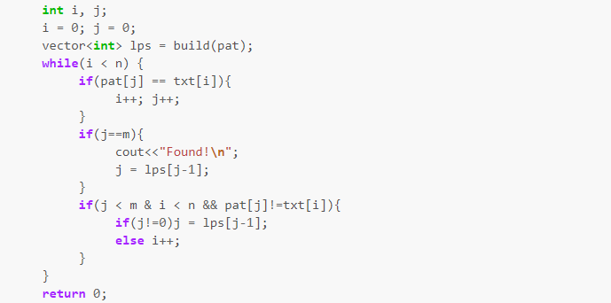
The String Matching

Slide 9
String Alignment(Edit Distance)
Given two strings str1 and str2 and below operations that can performed on str1. Find minimum number of edits (operations) required to convert ‘str1’ into ‘str2’.
Insert
Remove
Replace
For example, the edit distance between LOVE and MOVIE is 2, because we can first perform the operation LOVE ! MOVE (modify) and then the operation MOVE ! MOVIE (insert). This is the smallest possible number of operations, because it is clear that only one operation is not enough.
If we tried complete search on this trying all three possible every time and taking the minimum the time complexity would be O(3^{n}).

Slide 10
String Alignment(Edit Distance)
We can calculate values of distance as follows:
distance(a,b) = min(distance(a, b-1)+1, distance(a-1,b)+1, distance(a-1,b-1)+cost(a,b))
Here cost(a,b) = 0 if x[a] == y[b], and otherwise cost(a,b) = 1. The formula
considers the following ways to edit the string x:
distance(a,b-1): insert a character at the end of x
distance(a-1,b): remove the last character from x
distance(a-1,b-1): match or modify the last character of x

Slide 11
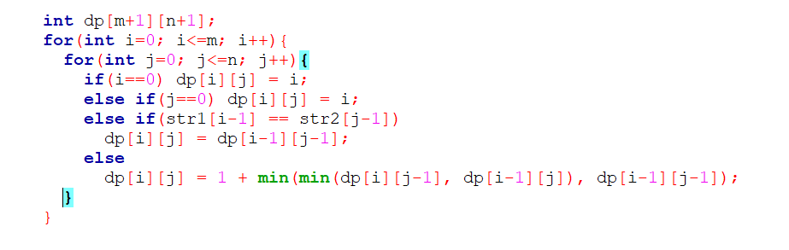
String Alignment(Edit Distance)

Slide 12
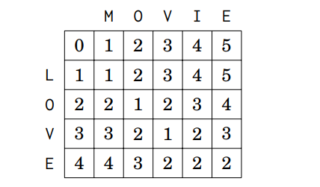
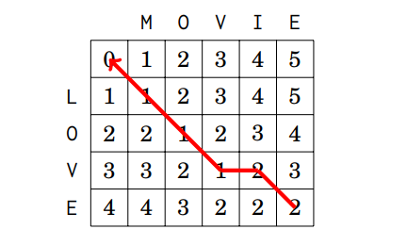
Example

Slide 13
Longest Common Subsequence
LCS Problem Statement: Given two sequences, find the length of longest subsequence present in both of them. A subsequence is a sequence that appears in the same relative order, but not necessarily contiguous. For example, “abc”, “abg”, “bdf”, “aeg”, ‘”acefg”, .. etc are subsequences of “abcdefg”.

Slide 14
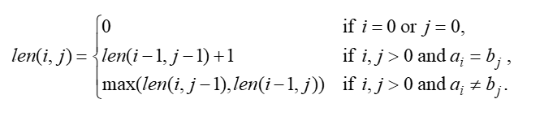
Longest Common Subsequence
Let A=a1a2…am and B=b1b2…bn .
len(i, j): the length of an LCS between a1a2…ai and b1b2…bj
With proper initializations, len(i, j) can be computed as follows.

Slide 15
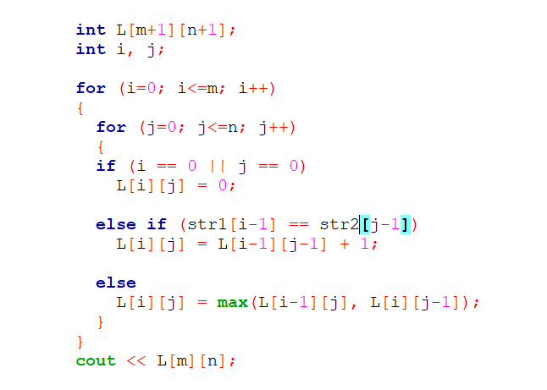
Longest Common Subsequence

Slide 16
Longest Common Subsequence

